Slide 1
Student Mental Health Analysis
ENTITY Academy
Sindy Saintclair

Slide 2
agenda
BACKGROUND 3
STEPWISE REGRESSION 4
LINEAR REGRESSION AND CROSS-VALIDATION 6
MAKING PREDICTIONS AND CHECKING THEIR ACCURACY 9
CONCLUSION(S) 17

Slide 3

background
This dataset was collected to conduct statistical research on the effects of mental illness/health on students’ CGPA. This data set was collected by a Google forms survey from students attending an Unnamed University to examine their current academic situation and mental health.
In this PowerPoint, we are going to examine the data and form predictions as to what factors or variables best influence one’s current grade point average, whether it be their sex, age, course, marital status, whether they have depression, anxiety, or panic attacks, as well as what year of school they are in.

Slide 4
Stepwise regression

Slide 5

Performing stepwise regression…
After some data wrangling and cleaning, an entirely new dataset was created for further analysis in Python, but for now, we will be discussing what was done in R Studio.
A summary of the entire linear model created from the newly cleaned data was called, to which I discovered that Fiqh and Biotechnology were courses that held the most significance in contributing to a student’s current GPA and mental health outcomes. Once a backwards stepwise regression was performed, the best fit model was found.
In other words, the y-intercept along with the male gender, Fiqh course, depression and anxiety diagnosis, and senior year of college are all major contributing factors to the current grade point average of these university students.
This equation accounts for nearly 33.34% of the data, which isn't that high and is counted as significant according to the p-value, deeming the y-intercept, Biotechnology, and Fiqh course as significant in determining one's CGPA.
Y(CGPA) = 2.597 + (-0.3171)’Choose your gender’Male + (-3.000)’What is your course?’ + (-0.2789)’Do you have Depression?’Yes + (0.3931)’Do you have Anxiety?’Yes + (0.6678)’Year’4

Slide 6
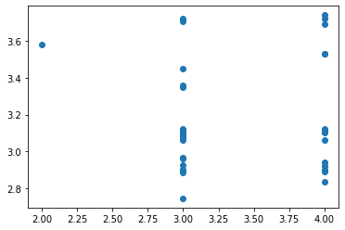
Linear regression and cross validation Part 2
To perform a linear regression, the independent variables determined for x after taking the newly cleaned data and further wrangling it in Python were Depression, Anxiety, Course, Gender, and Current Year in College. The y variable, or dependent variable that will be examined, is the current grade point average or CGPA.
A scatterplot of the predictions(predictions of x_test) and y_test was created as well as the accuracy score of the linear regression fitted from the x_train and y_train which is shown on the right. The accuracy score of the linear regression was then calculated, which further determined that there was a lack of linearity present due to its negative accuracy score and appearance.
In other words, there was no direct or linear relationship between the dependent variable and the independent variables.

Slide 7
Mean absolute error, mean squared error, root mean squared error (RSME)
The mean absolute error of the y_test and the predictions was 0.524, which is rather close to zero. This means that there’s nearly 0 error!
The square of the absolute error is 0.452 and is usually taken into account for large amounts of error in real-world applications—also close to zero.
The RMSE was 0.672, which is also rather close to zero, deeming this model an excellent fit

Slide 8
creating k-folds and running cross validation
After the linear regression and accuracy-checking of the model, I created k-folds to create more iterations of the training data and to test the final model.
I ran the cross-validation on the linear regression, the independent variables, and the dependent variable and acquired three scores for each model created for the k-folds.
All cross-validation scores were -0.431, -0.298, -0.186, meaning that the first trained model was accurate -43.05% of the time, the second model was accurate -29.80% of the tie, and the third model was accurate -18.61% of the time—all of which are to put it bluntly, horrible! Probably since linear regression isn’t the best model for a dataset with many independent variables and one dependent variable.

Slide 9
making predictions and checking their accuracy
Complete a KNN classification model, confusion matrix, and assessing accuracy of model

Slide 10

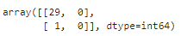
Making predictions and checking their accuracy
From the last dataset for Student Mental Health, we will be choosing to predict whether treatment is sought for college students by these four variables: gender, marital status, and whether they suffered from depression, anxiety, and/or panic attacks.
To begin, I performed k_nearest neighbors in python, which involved scaling the data, creating x and y variables along with x and y training data and x and y testing data. I performed a trial run and then KNN analysis by creating a confusion matrix of the y_test and the predictions (x_test predictions).

Slide 11
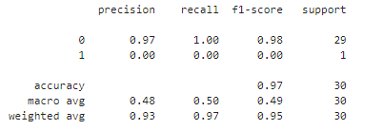
Interpretation of confusion matrix
Interpreting knn predictions
This shows how the predicted data lines up with reality. There are two different outcomes: students who sought treatment and those who did not. It appears from a trial run of 0.3 test size that 29 individuals did not seek treatment from specialists whereas perhaps only 1 out of the entire test size sought treatment.
Classification report of y_TEST and PREDICTIONS
According to the classification report to the right, the KNN algorithm was 97% correct in predicting how many college students did not seek treatment and was 0% accurate in predicting the number of college students that did seek treatment. For the weighted average which measures precision, the entire KNN algorithm was 93% accurate.

Slide 12
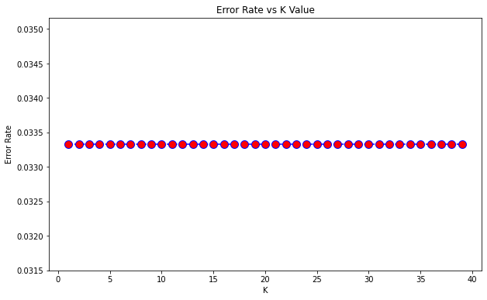
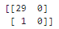
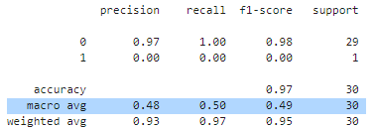
increasing accuracy level
Elbow method
A way to plot error to see which number of neighbors is best
In this case, all k values are at a stable 0.0334 error rate which might as well be zero—a strong indication of low error.
Running the final model using one of the k values
Since any one of the k values would give the same result due to them being stable in nature, we will choose 20 for the sake of experimentation
The final model ended up displaying the same results as
previous test: 97% accuracy in predicting the number of students
that did not seek treatment and 0% in predicting the students
that did, with a 93% overall accuracy.

Slide 13
creating a random forest model
w/ optimal hyperparameters by performing hyperparameter tuning using RanadomSearchCV

Slide 14
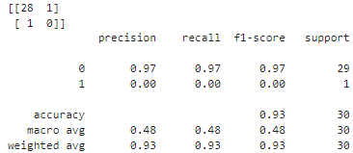
after creating a random forest model…
After selecting 800 as the number of estimators and making forest predictions on x_test, a confusion matrix and classification report were formed. This confusion matrix shows that 28 college students were found to have not sought treatment after predictions were made that they would have. Only one of these students was predicted to have sought treatment from a specialist.
This model is 93% accurate, with the number of predictions against college students seeking specialists for treatment at 97% while the prediction for students who sought specialists for treatment held an accuracy percentage of 0%.

Slide 15
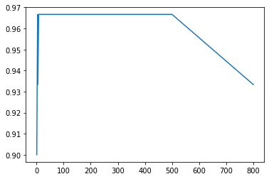
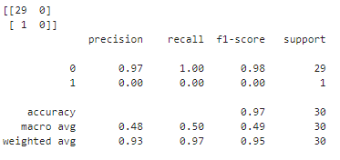
Hyperparameter tuning
Using sklearn’s RandomizedSearchCV and accuracy score, I managed to calculate which n_estimator held the highest accuracy score.
From it, it was determined that the n_estimator, 10, held the highest accuracy score of 96.7%. When plotted, you can see a sharp increase where 10 would be on the x-axis before remaining at 0.967 on the y-axis until after n_estimator 500..
And still the overall accuracy of the random forest model was 93%.

Slide 16









feature importance
CGPA
0.030992
course
Depression diagnosis
Panic attacks
age
0.300175
0.155276
0.088925
0.139477
Marital status
Current year in college
anxiety
gender
0.087965
0.079507
0.078157
0.039523

Slide 17
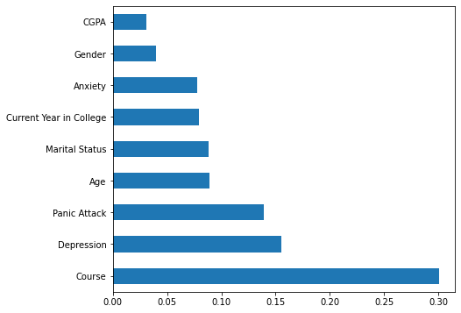
conclusions
Main points
Questions to explore in the future
Feature importance
Though there may not have been a direct linear relationship between the dependent variable and the independent variables, multiple logistic regression would have probably been more suitable for analysis.
More college students were less likely to seek out specialists for treatment for their mental health
The type, of course, the students were taking ultimately had the highest influence over their CGPA and mental health. In this case, Fiqh and Biotechnology were the two courses that held the most significance. Behind course name was whether or not they had depression.
What is keeping students from seeking specialists for treatment for their mental health?
What about biotechnology and Fiqh laws contribute so much to how high or low someone’s CGPA is? Could the course(s) be contributing to their mental illness?

Slide 18

summary
In short, we learned that this data and the analyses from it were not that accurate in determining the relationship or importance of the select independent variables on the dependent variable, current grade point average. But courses did contribute to all university students’ current GPA the most out of all the other features present in the dataset. Going forward, I will either use better, more organized data (or deep clean it myself even further) when seeking to analyze student mental health. In terms of better, I would hope that the data groups the courses appropriately and do not rely so heavily on recoding to categorize courses, for instance—as I did run into the issue where there were multiple versions of the same course.

Slide 19
thank you
Sindy Saintclair
sdstclair@outlook.com
https://sindysaintclair.com

